Slide 1
JAPAKEYS
a WIP concept for Capstone
Group #4
Shawn Witter | Matt Walsh | Holly Franks
12 March 2018

Slide 2
The Problem
Learning a language: difficult and tedious
Many language learning apps cannot hold the user’s attention
For instance… Most Japanese apps for android do not live up to expectations

Slide 3
The Proposal
Japakeys—An educational game designed to teach the user Japanese
Has some RPG and collectible elements to hold user interest
Takes the concept of “quizzing” to the next level
Learn Japanese naturally, step by step—but at a quick pace!

Slide 4
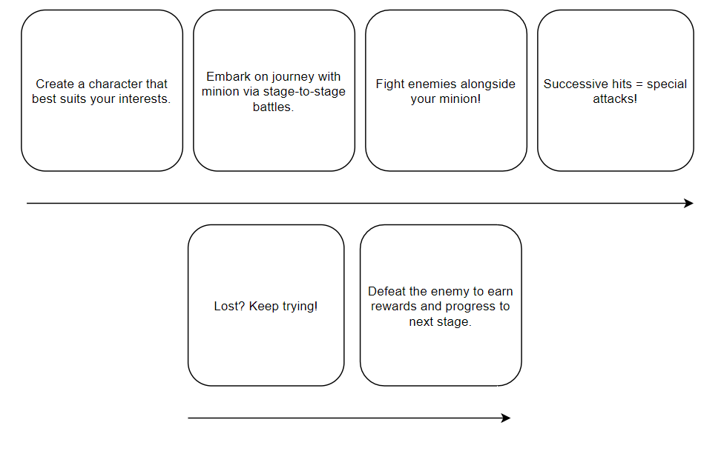
Game Design

Slide 5
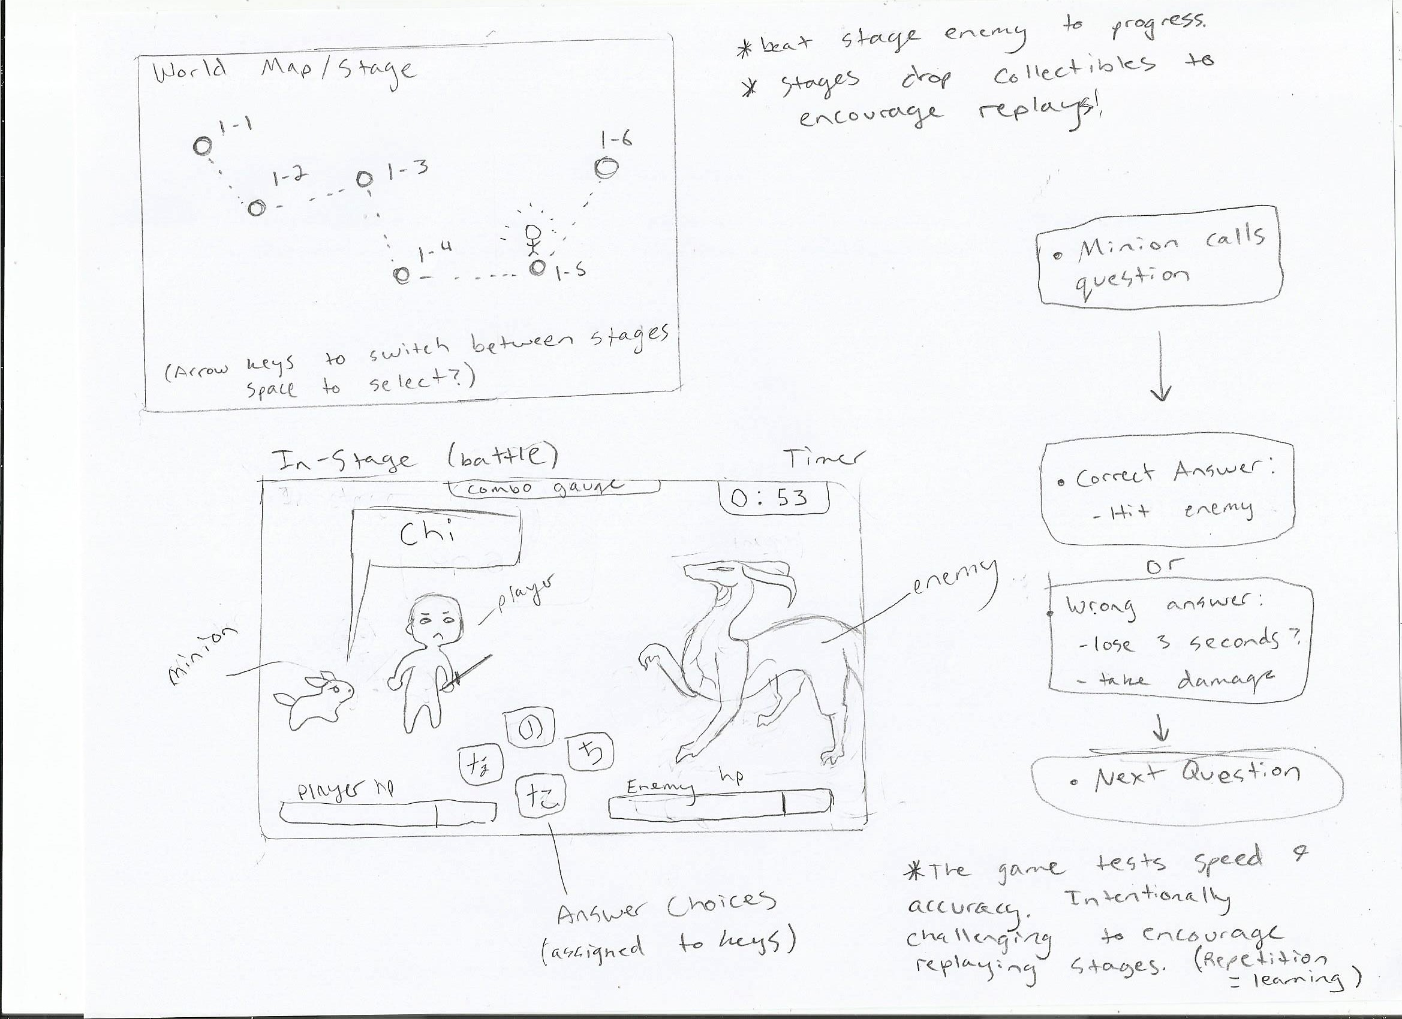

Slide 6
Game Questions and Database Work
Each letter or word is stored with two questions and answer choices.
These rows will be turned into objects that will be stored in a list.
During battle, one of the objects created is selected from the list and then one its two questions are chosen to be the next question asked to the player.

Slide 7
Language & Platform
C#
Monogame (Visual Studio)
Cross-platform (PC)
Potentially Android/iOS

Slide 8
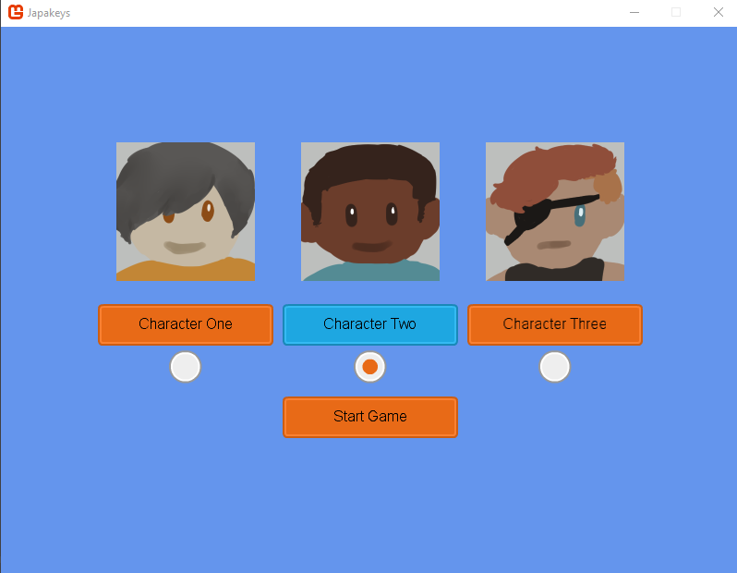
Concept of Character Selection

Slide 9
Why?
Group had strong interest in creating a game
Educational game that solves a problem
Language considerations
Japanese + RPG: often the same target market

Slide 10
Questions?

